Slide 1
Fire Alarm Prediction
Steven Kusuma - FTDS Batch 015

Slide 2
Table Of Content
Objective and Models
2. Dataset
3. Exploratory Data Analysis
4. Data Preprocessing
5. Model Evaluation
6. Sample Testing

Slide 3
Objective
Models
Classification Model to detect smoke that will trigger Fire Alarm.
Logistic Regression
SVM
Random Forest
Gradient Boosting

Slide 4
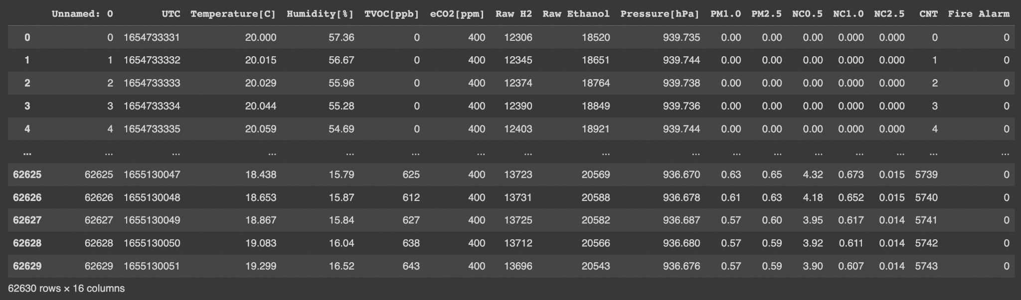
Dataset
Data consists of 62,630 rows and 16 columns, all are integers.
https://www.kaggle.com/datasets/deepcontractor/smoke-detection-dataset

Slide 5
Exploratory Data Analysis

Slide 6
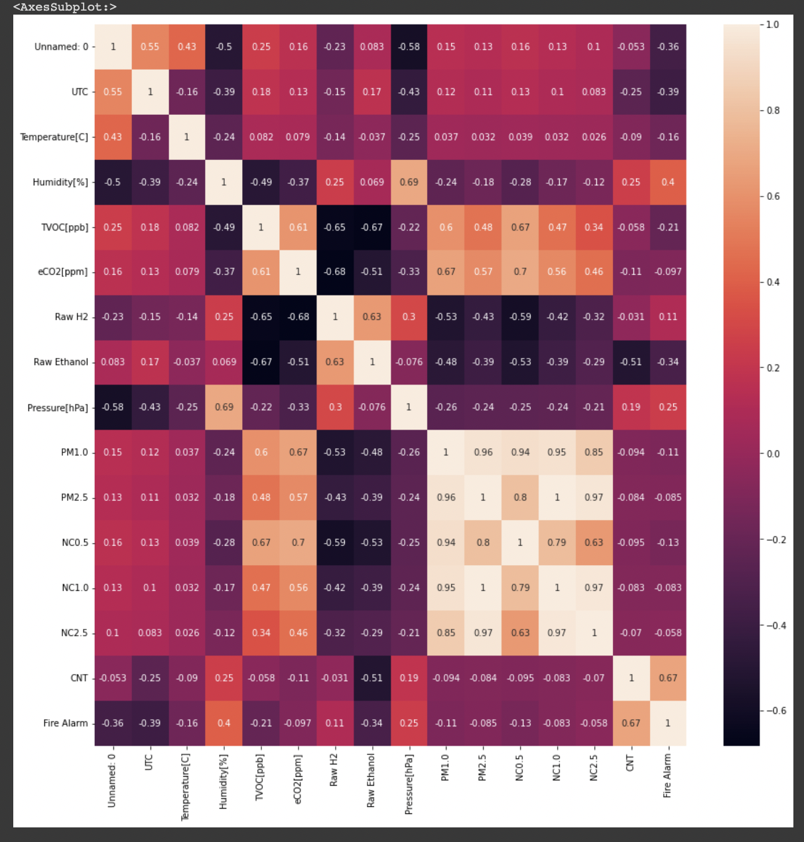
Correlation Matrix

Slide 7
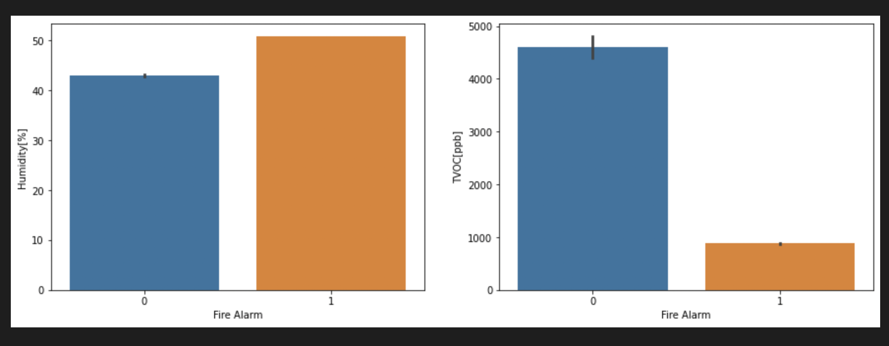
1. Higher humidity % will trigger Fire alarm. Because smoke will increase humidity in air and thus Fire alarm is triggered.
2. The lower the Total Volatile Organic Compounds will trigger fire alarm
Ground Truth = 1 “if a fire is presence”
What Triggers Fire Alarm?

Slide 8
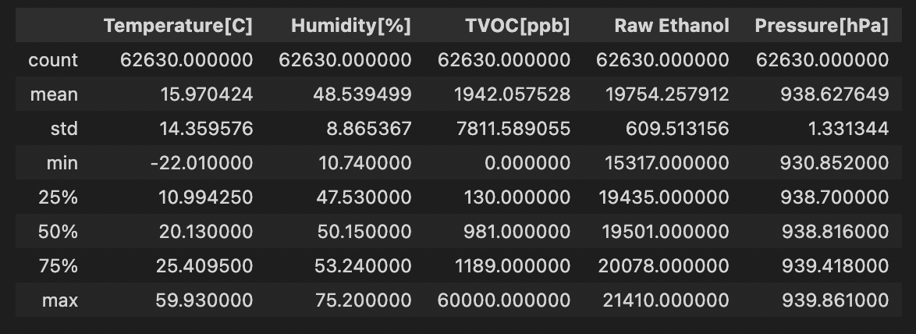
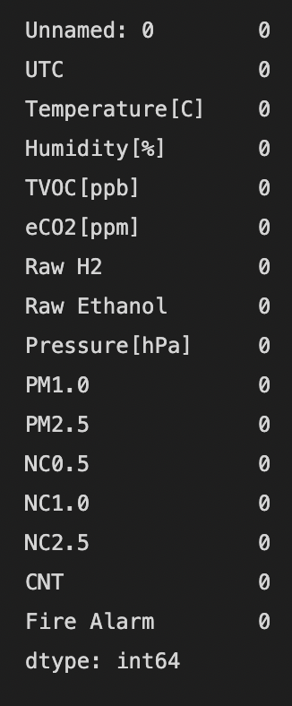
Data Preprocessing
Handling
Feature
Outliers
Missing Values
Scaling
Encoding
MinMaxScaler
No Encoding
As the mean and 50% is not significantly different, data is fairly normally distributed. Therefore no handling outliers are needed.
No Missing Values to handle

Slide 9
Model Evaluation

Slide 10
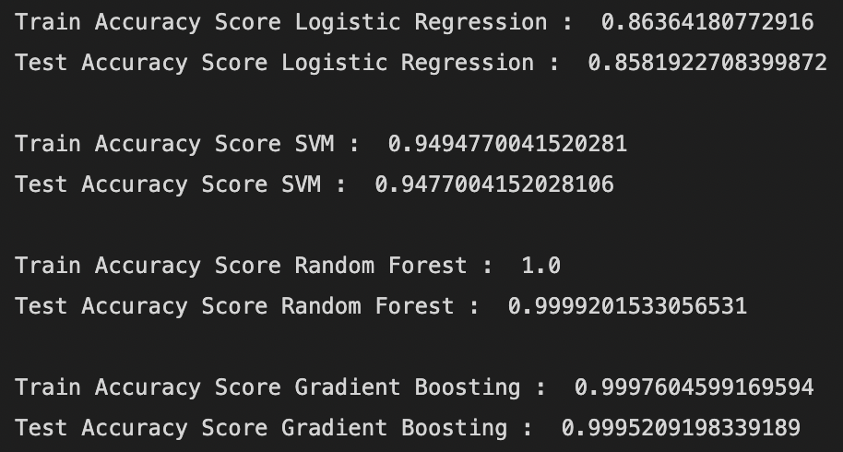
Accuracy Score

Slide 11
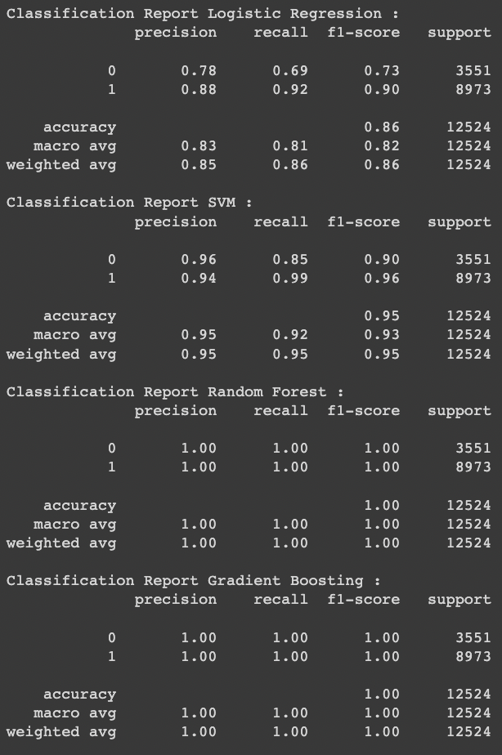
Classification Report
Random Forest and Gradient Boosting outcome the best result, however Gradient Boosting is prone to overfitting.
So, Random Forest is the best model.

Slide 12
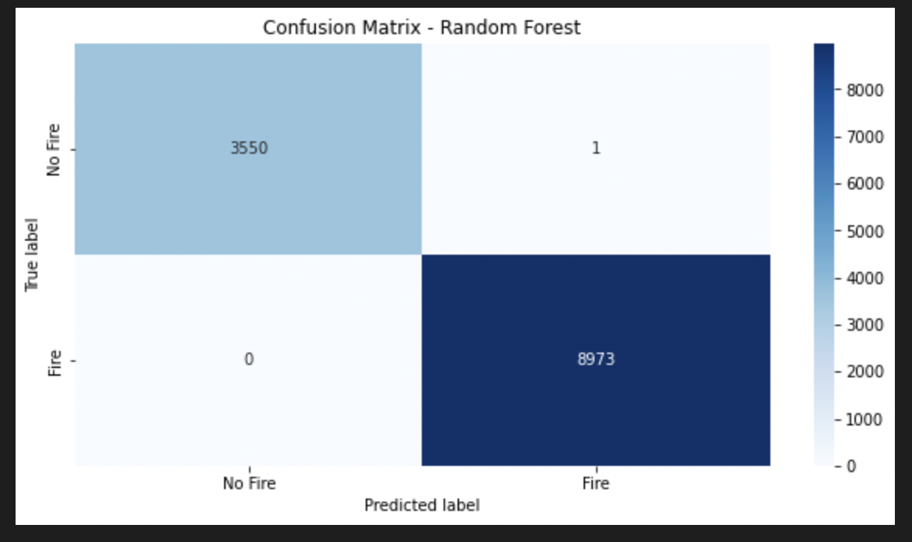
Random Forest
Test Accuracy level : 99.992%
Random Forest predicts almost all true.
The main concern is as if :
True label = Fire
Predicted label = No Fire
as a result might be late to react.

Slide 13
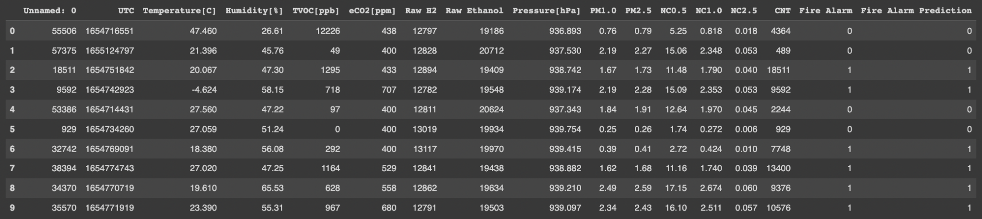
Sample Testing using Random Forest
All sample correctly predicted using Random Forest.
True Label
Predicted Label

Slide 14
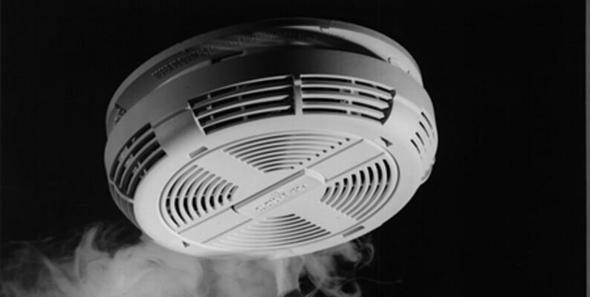
Thank you!
But wait!
https://fire-prediction-steven-kusuma.herokuapp.com/

Slide 15
Deployment App Demo
True Label
Predicted Label

